Slide 1
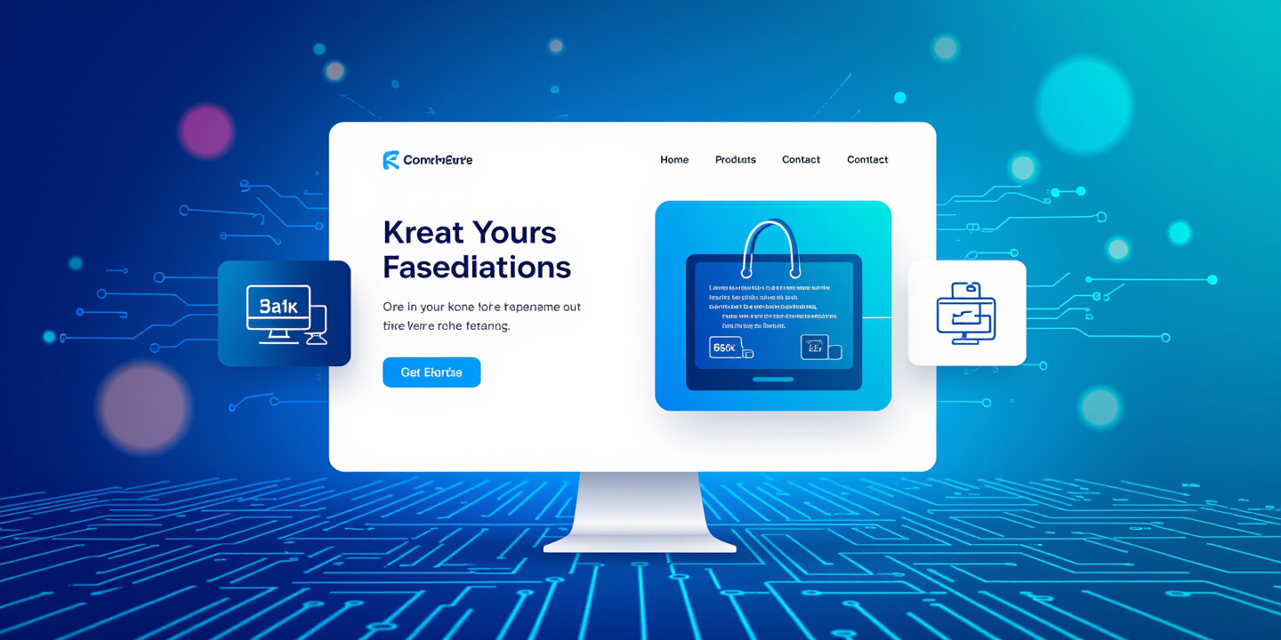
CART CODERS – Web Development Showcase
A front-end project demonstrating our proficiency in HTML5 and CSS3. This presentation highlights our attempt to replicate the Amazon homepage, focusing on responsive design and UI replication without using JavaScript.

Slide 2
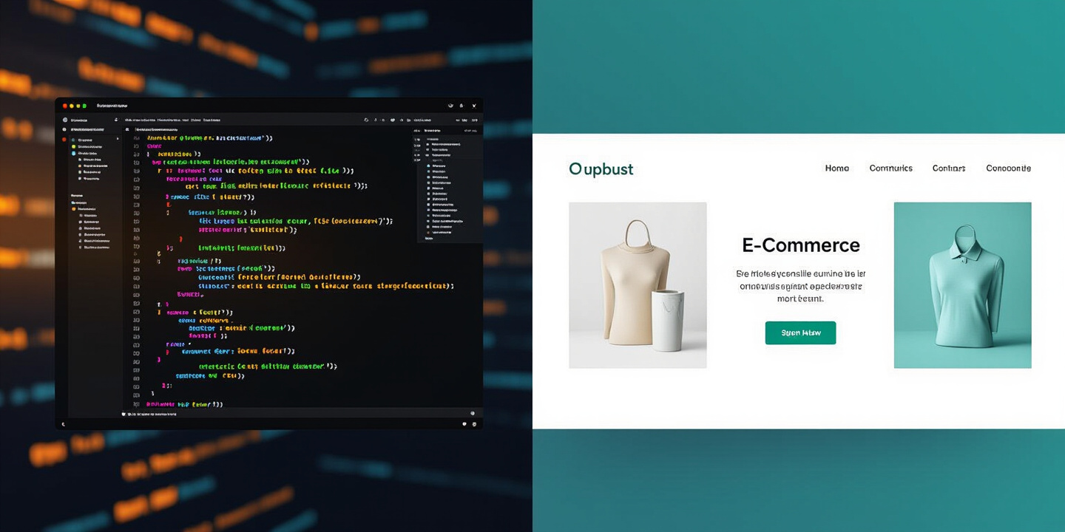
About the Website – Lootcart
Our project, the "Shopazon," is a static website built using HTML5 and CSS3. The primary objective was to recreate the visual layout and structure of Amazon's homepage, providing a practical exercise in front-end development and responsive design techniques. it’s similar to amazon website but we add some unique ideas.

Slide 3
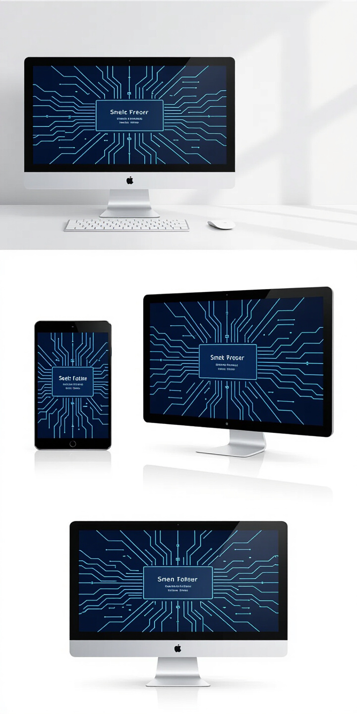
Project Goals
The key goals for this project were:
Practicing responsive design principles to ensure compatibility across different screen sizes.
Understanding the process of replicating a real-world UI, focusing on design accuracy.
Mastering front-end development skills using only HTML and CSS, without relying on JavaScript.

Slide 4
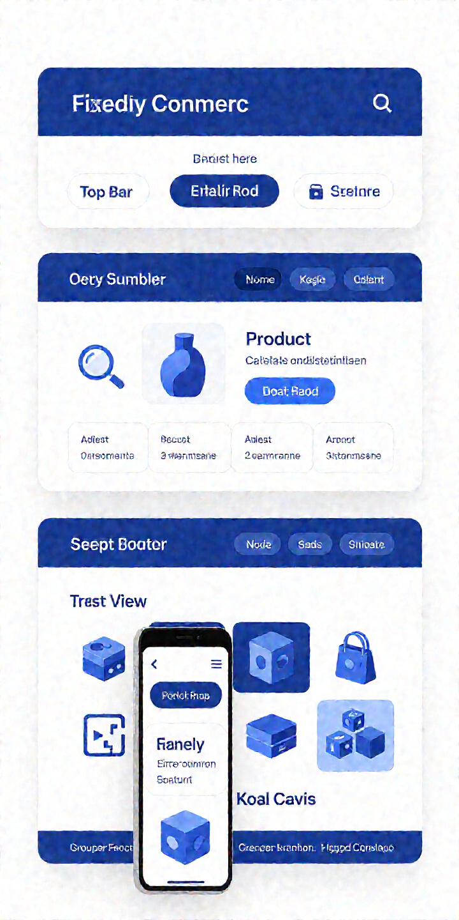
Key Features & Functionalities
The Lootcart website includes the following features:
Header with a search bar and shopping cart icon, mimicking Amazon's top navigation.
Hero banner section with a prominent image, similar to the Amazon promotional area.
Product grid layout to display items, mirroring Amazon's product listing.
Detailed footer design with multiple link sections for categories and help.
Mobile responsiveness achieved through Flexbox and Media Queries.

Slide 5
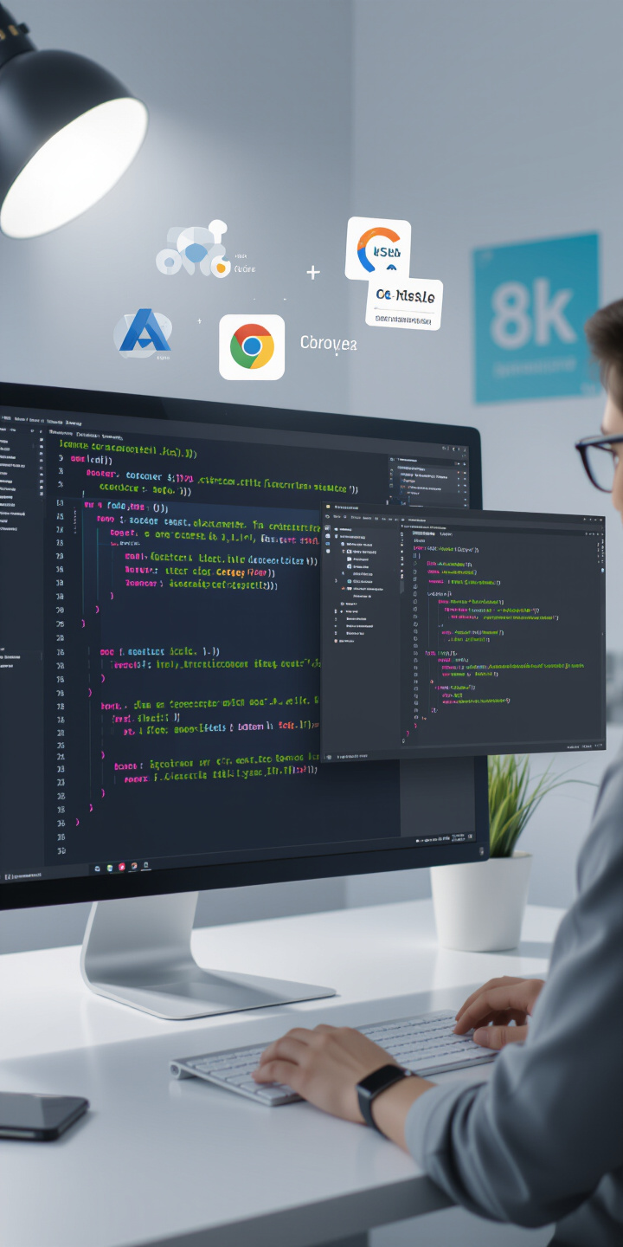
Design Choices & Tools Used
Key design decisions included:
Layout strategy focused on replicating Amazon's structure, using semantic HTML for clarity.
Modular CSS approach for maintainability and scalability.
Adherence to Amazon's design language, including color scheme and typography.
Tools used: VS Code, Chrome DevTools.

Slide 6
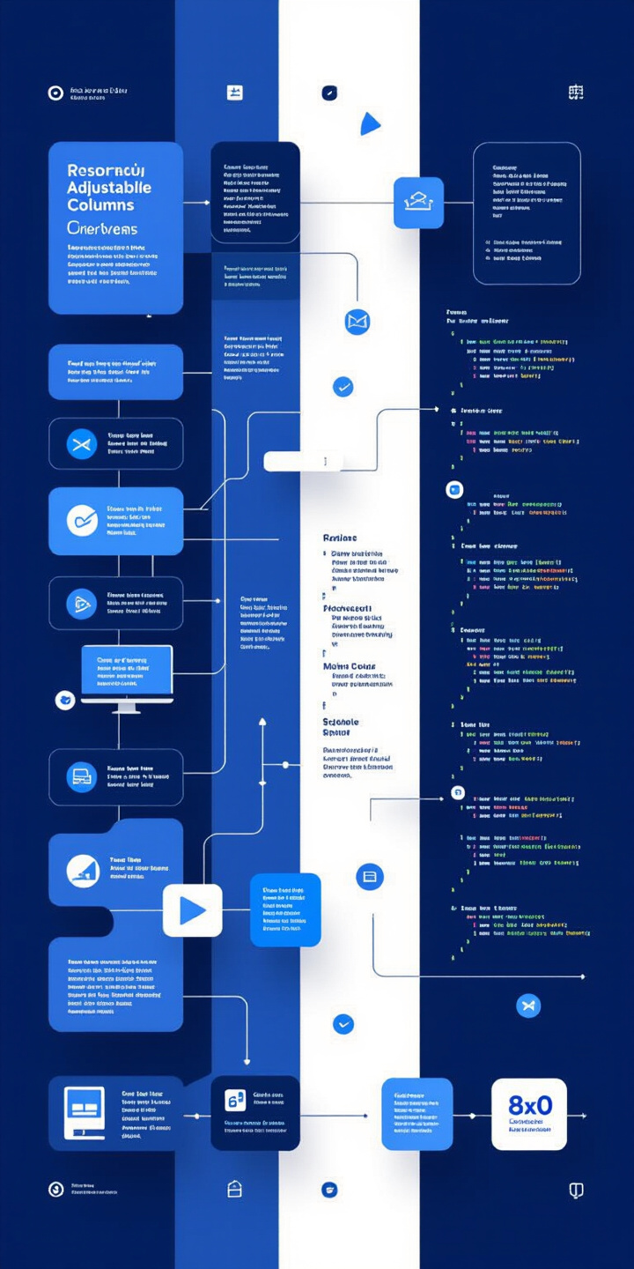
Responsive Design Implementation
We achieved responsiveness by using:
Flexbox for flexible layout and alignment of elements.
Media queries to adapt the layout and content based on screen size. This ensures optimal viewing on desktops, tablets, and mobile devices.

Slide 7
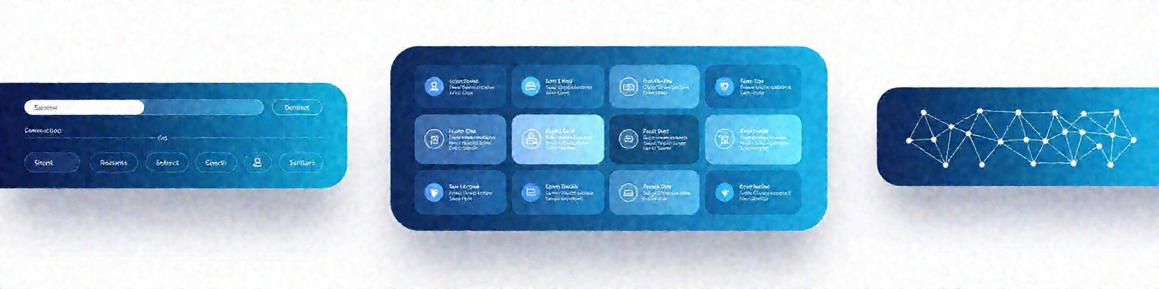
Core UI Components Recap
The core UI components we focused on were:
Navigation header: Ensuring it remains consistent across all screen sizes.
Product display grid: Replicating Amazon's product grid layout.
Hover effects: Adding subtle visual feedback on interactive elements.
Structured footer links: Organizing links for easy navigation.

Slide 8

Team Contributions
Dhairya: Created website structure & led project coordination.
Pranahu: Contributed ideas & presentation communication.
Dhruv: Designed the presentation & helped with design.
Priyanshu: Added responsiveness & making memory game for discount.

Slide 9

Lessons Learned
Through this project, we learned:
The importance of semantic HTML and modular CSS for maintainable code.
How to effectively use Flexbox and Media Queries for responsive design.
The challenges of replicating a complex UI without JavaScript.
The value of team collaboration in web development projects.

Slide 10

Thank You / Q&A
Thank you for your time and attention. We are now happy to answer any questions you may have about our Lootcart website project.

